Slide 1
NEH Summer Institute 2016 Veterans in Society: Ambiguities & Representations
THE ARTS AS A RESPONSE
TO THE COSTS OF WAR
WORLD WAR I AND IRAQ / AFGHANISTAN WARS – TODAY
Tara Leigh Tappert, Ph.D.

Slide 2
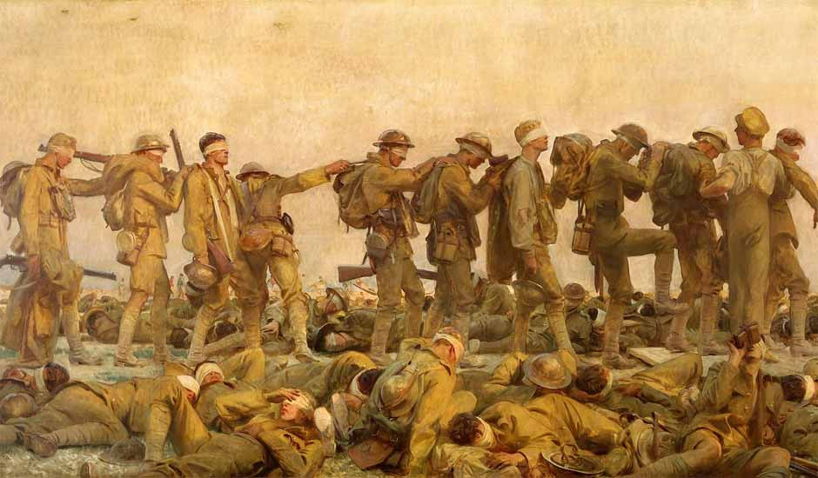
World War I and American Art – Exhibition
JOHN SINGER SARGENT
GASSED
1918 Oil on canvas Full painting – 91 x 240 1/2 in.
Imperial War Museum

Slide 3
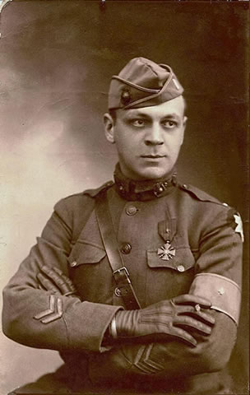
Claggett Wilson – U.S. Marine Corps
First Lieutenant Claggett Wilson, France, 1918

Slide 4
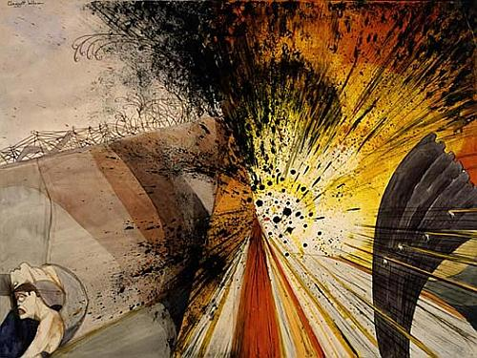
Flower of Death – The Bursting of a Heavy Shell – Not as It Looks, but as It Feels and Sounds and Smells
ca. 1919

Slide 5
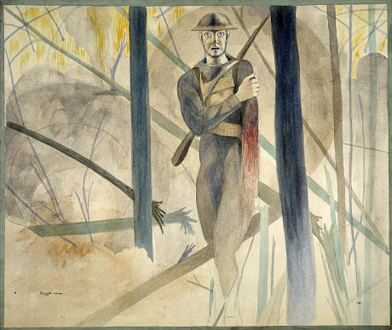
Runner Through the Barrage, Bois de Belleau, Chateau Thierry Sector; His Arm Shot Away, His Mind Gone
ca. 1919

Slide 6
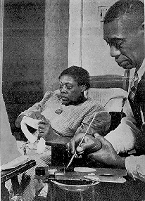
Horace Pippin – U.S. Army
Pippin and his wife Jennie

Slide 7
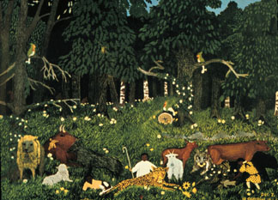
The Holy Mountain II (The Knowledge of God)
1944

Slide 8
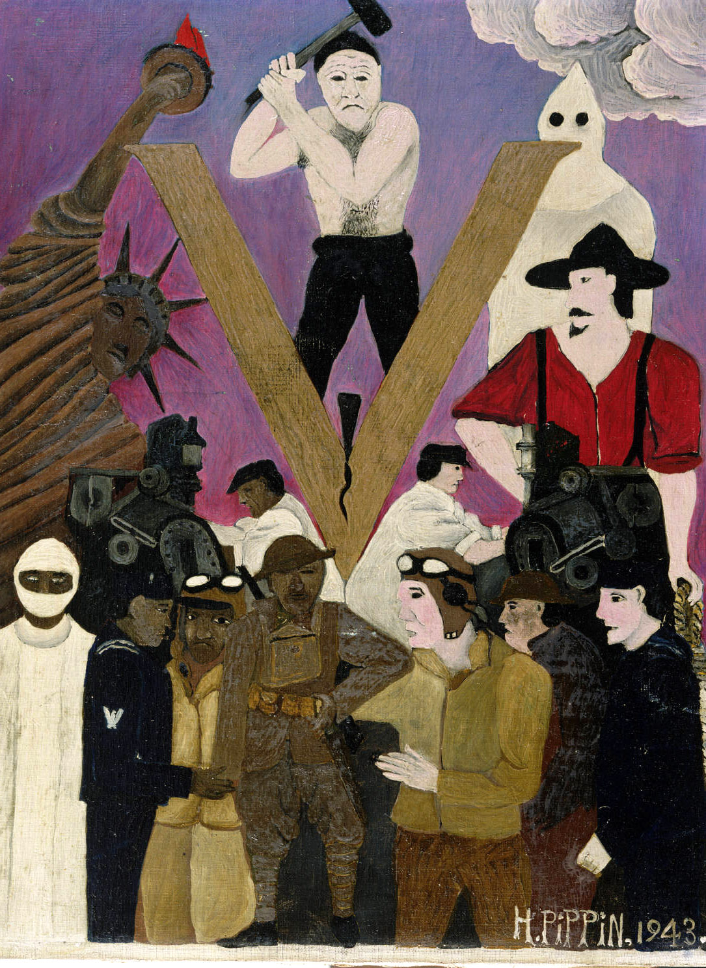
Mr. Prejudice
1943

Slide 9
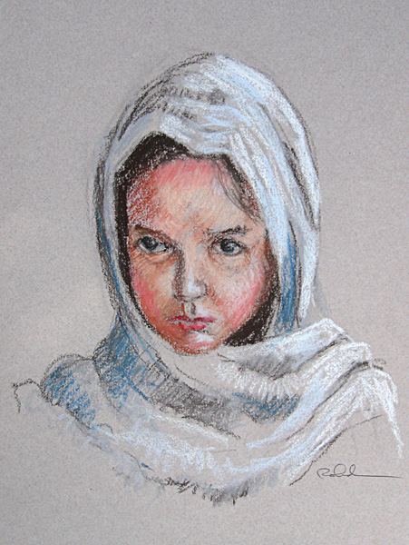
Citizen – Soldier – Citizen – Exhibition
SKIP ROHDE
LITTLE AFGHAN GIRL
2012
Pastel on Toned Paper 13 x 1 in.
Collection of the Artist

Slide 10
Jesse Albrecht – U.S. Army –Medic
Photo for The Art of War exhibit, 2015

Slide 11
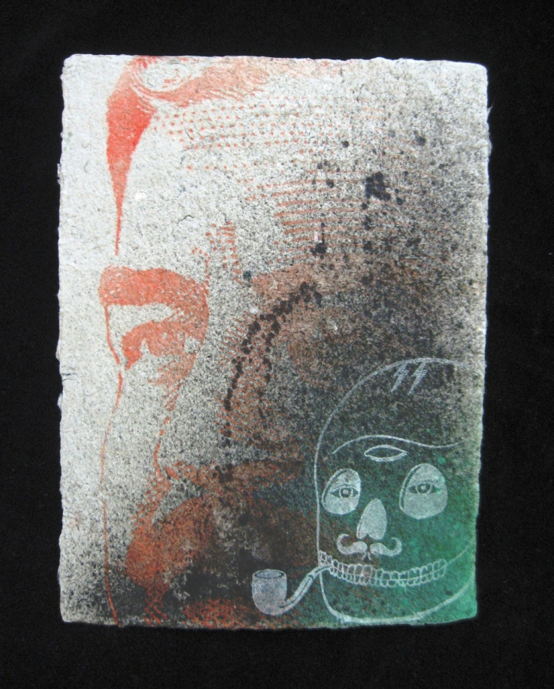
Saddam and Me
2010

Slide 12
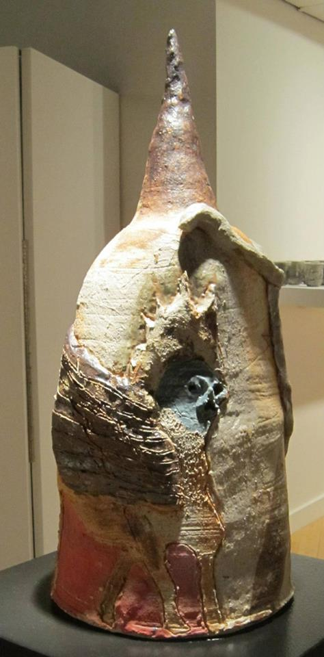
Ninevah
2013

Slide 13
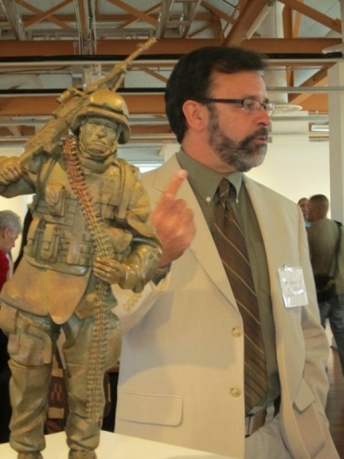
Michael D. Fay – U.S. Marine Corps
At the opening reception for the Arts and Stripes exhibit, Workhouse Arts Center, Lorton, Virginia, July, 2011

Slide 14
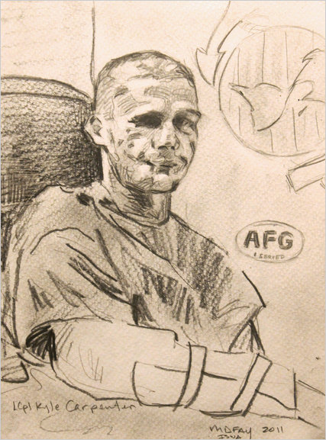
THE JOE BONHAM PROJECT Lance Corporal Kyle Carpenter USMC
2011

Slide 15
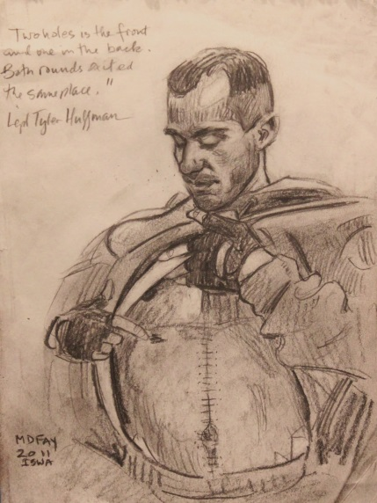
THE JOE BONHAM PROJECT Lance Cpl. Tyler Huffman USMC

