Slide 1
NEH – Veterans in Society Institute 2016 Group #2
Susan L. Eastman
Jim Craig
Norma Honaker
Howard Hastings

Slide 2
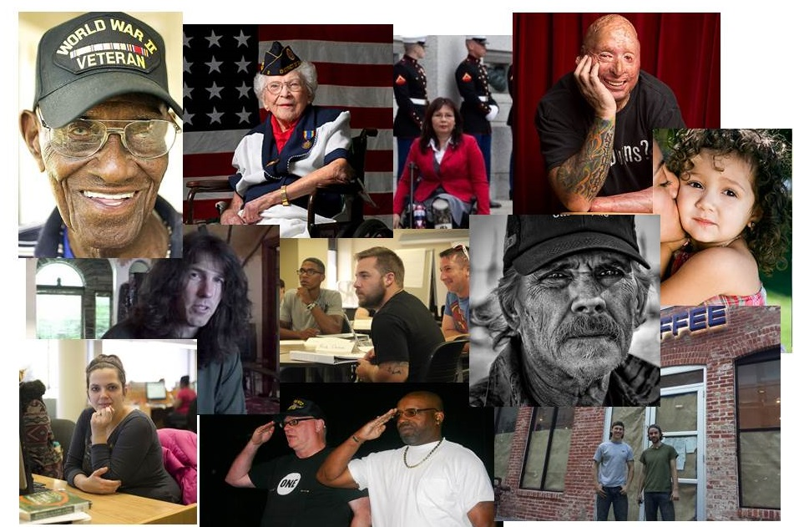
What is a Veteran?
Exploring veteran-ness from four perspectives
“We are creating an entire narrative around this word and we don’t even know what it means.” -Benjamin Busch, July 26, 2016

Slide 3
What is a Veteran?
Exploring veteran-ness from four perspectives
The purpose of this module is to explore several of the many lenses through which we can understand veterans
Method: 4 x 1-1.5 hour classes
Memorial Inquiry
Public Policy
Gender
Cultural and historical boundaries
A few common themes:
Identity
Achieved vs. claimed status
Inclusivity vs exclusivity
Historical context
Civil-military relations and societal connection

Slide 4
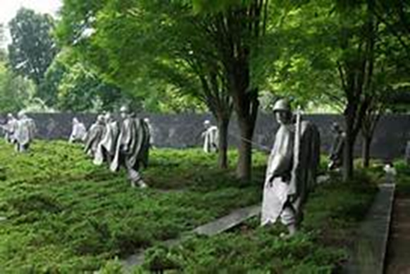
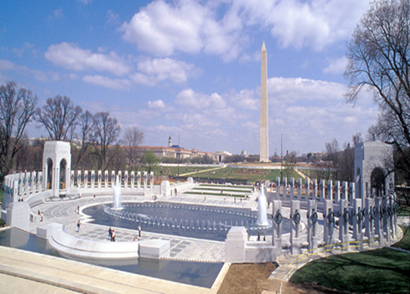
Memorial Inquiry Susan L. Eastman
Why are some memorials designated as “veteran” memorials and others are “war” memorials?
Conduct sight study
Questions include historical and cultural contexts of the war, group(s) or individual(s) commemorated, in addition to dedication date, location/space, materials, types of representations, potential controversies, etc.
Readings: NPS on the VVM, the WWII Memorial, and Piehler’s Remembering War the American Way (1995).
Notes:
VVM http://chontalikirk.blogspot.com/2013/04/great-americans-to-z-maya-lin.html WWII http://commonamericanjournal.com/%E2%80%A6december-7th-1941-%E2%80%94-a-date-which-will-live-in-infamy%E2%80%A6/
Korean https://images.search.yahoo.com/yhs/search;_ylt=A0LEVjJB5pdXTmUAh60nnIlQ;_ylu=X3oDMTEzdHV2ZmlzBGNvbG8DYmYxBHBvcwMxBHZ0aWQDRkZSVkJLXzEEc2VjA3Nj?p=Korean+War+Veterans+Memorial&fr=yhs-mozilla-002&hspart=mozilla&hsimp=yhs-002#id=70&iurl=http%3A%2F%2Fwww.ussjouett.com%2Fphotopages%2Freunion2014%2Fwashington%2Fimages%2FKorean%2520War%2520Veterans%2520Memorial_jpg_jpg.jpg&action=click

Slide 5
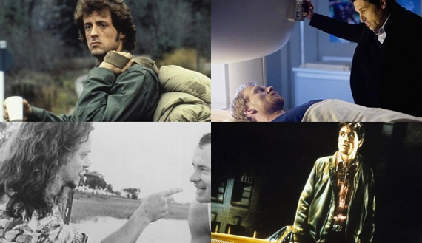
Veteran Status and Public Policy
Learning Objectives:
Classify veterans in our society, both formally (by law) and informally (by social convention)
Consider the implications are of inclusive and exclusive veteran constructs
Consider the implications of claimed vs achieved status
.
Methodology: Pre-class reading and preparation, in class small group discussion with Socratic questioning
Texts: USC and USCFR as well as several (magazine/newspaper) articles that portray a veteran narrative
Notes:
Purpose:
The purpose of this class is to explore the different notions of “veteran” in our society. Initially we will look at veterans from a public policy framework (compensation, benefits and social program). Later, we will look at veteran perceptions in popular media. At the end we will compare inclusive and exclusive constructs for veteran policies in various democratic countries
Learning Objectives:
After completing the readings and participating in the discussions, students will be able to
Classify who are and are not considered “veterans” in our society, both formally (by law) and informally (by social convention).
Consider thoughtfully the implications are of inclusive and exclusive veteran constructs
Consider the implications of personal experiences in veteran identification – claimed vs achieved status
Required Readings:
United States Code, Veteran’s Benefits, title 38 (2006) chapter 101-2.
Code of Federal Regulations, Department of Veterans Affairs, title 38, sec 3.12(a).
U.S. Library of Congress. Congressional Research Service. Who Is a “Veteran”?—Basic Eligibility for Veterans’ Benefits, by Scott D. Szymendera. R42324. 2016.
Meloy, Guy S. "Who and What Is a Veteran?" Army Magazine, Nov. 2012, 20-21.
Hoit, Kate. 2012. “The “Dangerous” Veteran: An Inaccurate Media Narrative Takes Hold,” The Department of Veterans Affairs, http://www.blogs.va.gov/VAntage/6026/the-%E2%80%9Cdangerous%E2%80%9D-veteran-an-inaccurate-medianarrative-takes-hold/
Satel and McNally “Retiring the Vietnam-Vet Stereotype” Atlantic Magazine November 11, 2013.
Dandeker, Christopher, Simon Wessely, Amy Iversen, and John Ross. 2006. "What's in a Name? Defining and Caring for "Veterans." Armed Forces & Society (0095327X) 32, no. 2: 161-177.
Additional Readings:
Howard Burdett, et al. "“Are You a Veteran?” Understanding of the Term “Veteran” among UK Ex-Service Personnel: A Research Note." Armed Forces & Society (0095327X) 39, no. 4: 751-759.
Questions for Class Discussion:
Close your eyes and imagine a veteran. What do you see?
How does this construct fit with public policy definitions?
Should our public policy change to match popular conceptions of veterans?
How should our popular conceptions of veteran change (or remain the same)?
How have other democratic countries tackled this public policy issue? Can we learn from their experiences, or is the American experiences so different from European experiences that these constructs are not particularly helpful?
So what?

Slide 6
Textual Analysis of The Gendered Veterans Body in Self Representations
Veteran as a politicized body marked by service, as spectacle of the masculine warrior.
Gender as a social construct maintained by ritual and norms.
Gender is about how you feel, but it is also about how others respond to you.
Devin Mitchell series
The Veteran Art Project
Choose an image and analyze how it communicates meaning. Complete textual analysis.
Questions to Consider
What is the relationship between the veteran and the military service member?
How is the individual’s gender performed or maintained in both images?
What connections to the discussions of women veterans experience can you make here?

Slide 9
